Slide 1
Lecture 3 Security Best Practices (7 Touchpoints)

Slide 2
Objectives
Give an Introduction to Security Best Practices
Specific attention will be given to
Code Review
Architectural Risk Analysis
Penetration Testing

Slide 3
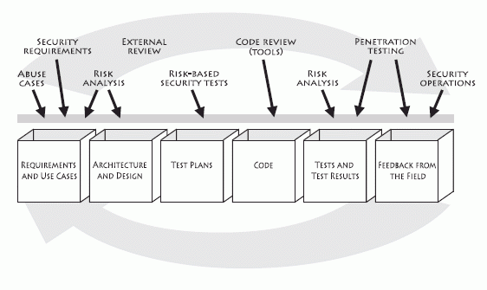
7 Best Practices (Touchpoints)
Security Best Practices can be applied during software development
Security best practices
Design
Implementation
Testing
Software engineering activities

Slide 4
7 Best Practices (Touchpoints)
Some touchpoints are more powerful than others
Code Review
Architectural Risk Analysis
Penetration testing
Risk-based security tests
Abuse cases
Security requirements
Security operations
Notes:
The proposed ranking is based on years of experience that Gary McGraw acquired by applying touchpoints to many different types of organizations ranging from independent software vendors to huge credit card consortia

Slide 5
7 Best Practices (Touchpoints)
Security best practices
Design
Implementation
Testing
Software engineering activities

Slide 6
Code Reviews
Scan code to identify common implementation bugs
Can only identify at most 50% of all possible vulnerabilities
Look for a fixed set of patterns (hardcoded rules)
Cannot rank vulnerabilities depending on criticality
High false positive and false negative rates.
Performed with automated static analysis tools:
Fortify
SonarQube
grep
Notes:
The proposed ranking is based on years of experience that Gary McGraw acquired by applying touchpoints to many different types of organizations ranging from independent software vendors to huge credit card consortium

Slide 7

Open-source platform developed to perform automatic reviews with static analysis of code to detect bugs, code smells and security vulnerabilities.
Supports 20+ programming languages (Java, JavaScript, C#, C/C++,Phyton,…)
Can integrate with various development environments such as Eclipse and IntelliJ
Can integrate with distributed version repositories (Git)
Notes:
SonarQube started 10 year ago as a way to measure the maintainability of source code and manage its technical debt.
This is made possible through the addition of cross procedural data flow analysis within files.
Nowadays SonarQube can detect memory leaks, advanced cases of null pointer dereferences, conditions that are always true or false regardless of the execution path etc.
SonarQube detect proven vulnerabilities and especially the ones relating to the OWASP Top 10 Categories. Starting from the user entry points of the applications the main challenge is to detect the unsafe user inputs which flow into some sensitive actions (construction of: SQL requests, directory paths, command lines) without being first sanitized

Slide 8
Open-source platform developed to perform automatic reviews with static analysis of code to detect bugs, code smells and security vulnerabilities.
Supports 20+ programming languages (Java, JavaScript, C#, C/C++,Phyton,…)
Can integrate with various development environments such as Eclipse and IntelliJ
Can integrate with distributed version repositories (Git)
Notes:
SonarQube started 10 year ago as a way to measure the maintainability of source code and manage its technical debt.
This is made possible through the addition of cross procedural data flow analysis within files.
Nowadays SonarQube can detect memory leaks, advanced cases of null pointer dereferences, conditions that are always true or false regardless of the execution path etc.
SonarQube detect proven vulnerabilities and especially the ones relating to the OWASP Top 10 Categories. Starting from the user entry points of the applications the main challenge is to detect the unsafe user inputs which flow into some sensitive actions (construction of: SQL requests, directory paths, command lines) without being first sanitized
Static analysis: analysis of code before being executed

Slide 9
Open-source platform developed to perform automatic reviews with static analysis of code to detect bugs, code smells and security vulnerabilities.
Supports 20+ programming languages (Java, JavaScript, C#, C/C++,Phyton,…)
Can integrate with various development environments such as Eclipse and IntelliJ
Can integrate with distributed version repositories (Git)
Notes:
SonarQube started 10 year ago as a way to measure the maintainability of source code and manage its technical debt.
This is made possible through the addition of cross procedural data flow analysis within files.
Nowadays SonarQube can detect memory leaks, advanced cases of null pointer dereferences, conditions that are always true or false regardless of the execution path etc.
SonarQube detect proven vulnerabilities and especially the ones relating to the OWASP Top 10 Categories. Starting from the user entry points of the applications the main challenge is to detect the unsafe user inputs which flow into some sensitive actions (construction of: SQL requests, directory paths, command lines) without being first sanitized

Slide 10
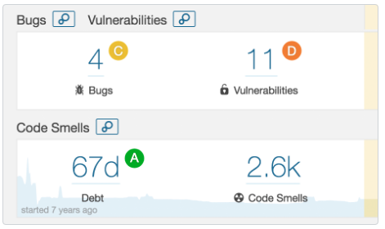
Features
Continuous Inspection
What is the quality of your code?

Slide 11
Features
Bugs: Defect in your code that may cause a failure in your software project
Examples:
Arithmetic bugs (e.g., division by zero, arithmetic overflow)
Syntactic bugs (x = 5 instead of x == 5)
Logic bugs (e.g., infinite loops)

Slide 12
Features
Code Smells: Characteristics in the source code of a program that may hinder its maintenance.
Examples:
Duplicated code
Large classes
Shotgun surgery
Notes:
Duplicated Code: identical or very similar code exists in more than one location
Shotgun surgery: a single change needs to be applied to multiple classes at the same time
Bad code smells can be an indicator of factors that contribute to technical debt

Slide 13
Features
Debt: Estimated time required to fix bugs, vulnerabilities and code smells.
Notes:
Duplicated Code: identical or very similar code exists in more than one location
Shotgun surgery: a single change needs to be applied to multiple classes at the same time
Bad code smells can be an indicator of factors that contribute to technical debt

Slide 14
7 Best Practices (Touchpoints)
Some touchpoints are more powerful than others
Code Review
Architectural Risk Analysis
Penetration testing
Risk-based security tests
Abuse cases
Security requirements
Security operations
Notes:
The proposed ranking is based on years of experience that Gary McGraw acquired by applying touchpoints to many different types of organizations ranging from independent software vendors to huge credit card consortia

Slide 15
7 Best Practices (Touchpoints)
Security best practices
Design
Implementation
Testing
Software engineering activities

Slide 16
Architectural Risk Analysis
Risk Analysis: Aims to identify and rank risks at some particular stage of the development life cycle.
Usually applied to architecture and design level artifacts
Discuss security issues around software
Learn about target of analysis
Determine probability of compromise
Report findings
Develop mitigation strategy
Perform impact analysis
Rank Risks
Notes:
Learn about target of analysis:
- Read and understand the specifications, architecture documents, and other designs materials
- Discuss and brainstorm about the target with a group
- Play with software if exists in executable form
- Identify threats and agree on relevant sources of attack
Discuss security issues:
Argue about how the product works and determine areas of disagreement and ambiguity,
Identify vulnerabilities,
Map exploits and begin to discuss possible fixes;
Gain an understanding of current and planned security controls
Determine probability of compromise: map out attack scenarios for exploits of vulnerabilities; balance controls against threat capacity to determine likelihood
Perform impact analysis: determine impact on assets and business goals; consider impact on the security posture
Develop a mitigation strategy: Recommend countermeasures to mitigate risks
Report findings: Carefully describe the major and minor risks with attention to impacts. Provide basic information regarding where to spend limited mitigation resources

Slide 17
Architectural Risk Analysis
Risk Analysis: Aims to identify and rank risks at some particular stage of the development life cycle.
Usually applied to architecture and design level artifacts
Various approaches have been proposed to perform risk analysis. We will have a look at the one proposed by Gary McGraw at Cigital.
Architectural risk analysis is a knowledge intensive process!
Notes:
Existing knowledge, for example coming from existing vulnerabilities databases and threat models is extremely important.
There is no substitute for experience and expertise

Slide 18
Architectural Risk Analysis Activities
Build a one-page overview of your system
Attack Resistance Analysis
Weakness Analysis
Ambiguity Analysis
Notes:
The proposed ranking is based on years of experience that Gary McGraw acquired by applying touchpoints to many different types of organizations ranging from independent software vendors to huge credit card consortium

Slide 19
One-Page Architecture Overview
Decomposition of the application into major components, processes, data stores and data communication flows, mapped against the environment where the software will be developed.
Let’s have a look at an example!
Notes:
the nature of software systems leads many developers and analysts to assume incorrectly that code level descriptions of software is sufficient to spot design problems. Although this may generally be true, it does not generally hold

Slide 20
Web Application Architecture
Presentation Tier: presents content and manages interaction with the user.
Application Tier: Performs required calculations and validations, manages users identification, session and state management, manages all data access for the presentation tier.
Data Tier: data storage and retrieval

Slide 21
Web Application Architecture
User logon flows are protected by SSL between the client and the Web Server
Notes:
However, our deployment pattern indicates that though the encrypted tunnel terminates at this tier, because of the threat inherent the zones occupied by the Web and application tiers, we really need to prevent eavesdropping inside and between these 2 tiers as well. This might indicate the need to establish yet another encrypted tunnel or, possibly, to consider a different approach to securing these data (message level encryption as opposed to tunneling)
One common benefit that proponents of TLS encryption frequently highlight is that when the solution is used, none of the data contained within a message is revealed - including the metadata such as the sender and recipient name, subject line and the date and time of the message. This is not the case with content encryption, which does not encrypt these details.
In certain scenarios, unencrypted metadata may still be able to provide an observer with a great deal of information about the message. For instance, it can give a hacker a clear idea of who is communicating with whom in a business, which may allow them to spot patterns and prepare attacks such as spear-phishing attempts.

Slide 22
Web Application Architecture
Establish another encrypted tunnel or consider an alternative approach such as message level encryption.
Notes:
However, our deployment pattern indicates that though the encrypted tunnel terminates at this tier, because of the threat inherent the zones occupied by the Web and application tiers, we really need to prevent eavesdropping inside and between these 2 tiers as well. This might indicate the need to establish yet another encrypted tunnel or, possibly, to consider a different approach to securing these data (message level encryption as opposed to tunneling)
One common benefit that proponents of TLS encryption frequently highlight is that when the solution is used, none of the data contained within a message is revealed - including the metadata such as the sender and recipient name, subject line and the date and time of the message. This is not the case with content encryption, which does not encrypt these details.
In certain scenarios, unencrypted metadata may still be able to provide an observer with a great deal of information about the message. For instance, it can give a hacker a clear idea of who is communicating with whom in a business, which may allow them to spot patterns and prepare attacks such as spear-phishing attempts.

Slide 23
Architectural Risk Analysis Activities
Build a one-page overview of your system
Attack Resistance Analysis
Weakness Analysis
Ambiguity Analysis
Notes:
The proposed ranking is based on years of experience that Gary McGraw acquired by applying touchpoints to many different types of organizations ranging from independent software vendors to huge credit card consortium

Slide 24
Attack Resistance Analysis
Use information about known attacks, attack patterns, and vulnerabilities to identify
“how does the system fare against known attacks?”
Involves 4 steps:
Identify general flaws using secure design literature and checklists
Using threat taxonomies (e.g., STRIDE) or knowledge base of historical risks
Map attack patterns
Identify risks in the architecture based on the use of checklists
Understand and demonstrate viability of these known attacks
Notes:
The proposed ranking is based on years of experience that Gary McGraw acquired by applying touchpoints to many different types of organizations ranging from independent software vendors to huge credit card consortium

Slide 25
Attack Resistance Analysis
Use information about known attacks, attack patterns, and vulnerabilities to identify
“how does the system fare against known attacks?”
Involves 4 steps:
Identify general flaws using secure design literature and checklists
Using threat taxonomies (e.g., STRIDE) or knowledge base of historical risks
Map attack patterns using a list of attack patterns
Identify risks in the architecture based on the use of checklists
Understand and demonstrate viability of these known attacks
Notes:
The proposed ranking is based on years of experience that Gary McGraw acquired by applying touchpoints to many different types of organizations ranging from independent software vendors to huge credit card consortium

Slide 26
STRIDE
Model of threats developed at Microsoft for identifying computer security threats
Spoofing:
Tampering:
Repudiation:
Notes:
Many of the protocols in the TCP/IP suite do not provide mechanisms for authenticating the source or destination of a message, and are thus vulnerable to spoofing attacks when extra precautions are not taken by applications to verify the identity of the sending or receiving host. IP spoofing in particular may be used to leverage man-in-the-middle attacks against hosts on a computer network

Slide 27
STRIDE
Model of threats developed at Microsoft for identifying computer security threats
Spoofing: A spoofing attack is a situation in which a person or program successfully masquerades as another by falsifying data to gain an illegitimate advantage.
Tampering:
Repudiation:
Notes:
Many of the protocols in the TCP/IP suite do not provide mechanisms for authenticating the source or destination of a message, and are thus vulnerable to spoofing attacks when extra precautions are not taken by applications to verify the identity of the sending or receiving host. IP spoofing in particular may be used to leverage man-in-the-middle attacks against hosts on a computer network

Slide 28
STRIDE
Model of threats developed at Microsoft for identifying computer security threats
Authenticity
Spoofing
Tampering:
Repudiation:
Notes:
Many of the protocols in the TCP/IP suite do not provide mechanisms for authenticating the source or destination of a message, and are thus vulnerable to spoofing attacks when extra precautions are not taken by applications to verify the identity of the sending or receiving host. IP spoofing in particular may be used to leverage man-in-the-middle attacks against hosts on a computer network

Slide 29
STRIDE
Model of threats developed at Microsoft for identifying computer security threats
Authenticity
Spoofing
Tampering: Intentional modification of products or information
Repudiation:
Notes:
Many of the protocols in the TCP/IP suite do not provide mechanisms for authenticating the source or destination of a message, and are thus vulnerable to spoofing attacks when extra precautions are not taken by applications to verify the identity of the sending or receiving host. IP spoofing in particular may be used to leverage man-in-the-middle attacks against hosts on a computer network

Slide 30
STRIDE
Model of threats developed at Microsoft for identifying computer security threats
Authenticity
Spoofing
Tampering:
Repudiation:
Integrity
Notes:
Many of the protocols in the TCP/IP suite do not provide mechanisms for authenticating the source or destination of a message, and are thus vulnerable to spoofing attacks when extra precautions are not taken by applications to verify the identity of the sending or receiving host. IP spoofing in particular may be used to leverage man-in-the-middle attacks against hosts on a computer network

Slide 31
STRIDE
Model of threats developed at Microsoft for identifying computer security threats
Authenticity
Spoofing
Tampering:
Repudiation: Impossibility to associate actions and operations to a unique individual
Integrity
Notes:
Many of the protocols in the TCP/IP suite do not provide mechanisms for authenticating the source or destination of a message, and are thus vulnerable to spoofing attacks when extra precautions are not taken by applications to verify the identity of the sending or receiving host. IP spoofing in particular may be used to leverage man-in-the-middle attacks against hosts on a computer network

Slide 32
STRIDE
Model of threats developed at Microsoft for identifying computer security threats
Authenticity
Spoofing
Tampering:
Repudiation:
Integrity
Accountability
Notes:
Many of the protocols in the TCP/IP suite do not provide mechanisms for authenticating the source or destination of a message, and are thus vulnerable to spoofing attacks when extra precautions are not taken by applications to verify the identity of the sending or receiving host. IP spoofing in particular may be used to leverage man-in-the-middle attacks against hosts on a computer network

Slide 33
STRIDE
Model of threats developed at Microsoft for identifying computer security threats
Information disclosure:
Denial of Service:
Elevation of priviledge:
Notes:
Denial of service is typically accomplished by flooding the targeted machine or resource with superfluous requests in an attempt to overload systems and prevent some or all legitimate requests from being fulfilled.
In a distributed denial-of-service attack (DDoS attack), the incoming traffic flooding the victim originates from many different sources. This effectively makes it impossible to stop the attack simply by blocking a single source.
The result of an elevation of priviledge is that an application with more privileges than intended by the application developer or system administrator can perform unauthorized actions.

Slide 34
STRIDE
Model of threats developed at Microsoft for identifying computer security threats
Information disclosure: Data leak or privacy breach
Denial of Service:
Elevation of priviledge:
Notes:
Denial of service is typically accomplished by flooding the targeted machine or resource with superfluous requests in an attempt to overload systems and prevent some or all legitimate requests from being fulfilled.
In a distributed denial-of-service attack (DDoS attack), the incoming traffic flooding the victim originates from many different sources. This effectively makes it impossible to stop the attack simply by blocking a single source.
The result of an elevation of priviledge is that an application with more privileges than intended by the application developer or system administrator can perform unauthorized actions.

Slide 35
STRIDE
Model of threats developed at Microsoft for identifying computer security threats
Confidentiality
Information disclosure:
Denial of Service:
Elevation of priviledge:
Notes:
Denial of service is typically accomplished by flooding the targeted machine or resource with superfluous requests in an attempt to overload systems and prevent some or all legitimate requests from being fulfilled.
In a distributed denial-of-service attack (DDoS attack), the incoming traffic flooding the victim originates from many different sources. This effectively makes it impossible to stop the attack simply by blocking a single source.
The result of an elevation of priviledge is that an application with more privileges than intended by the application developer or system administrator can perform unauthorized actions.

Slide 36
STRIDE
Model of threats developed at Microsoft for identifying computer security threats
Confidentiality
Information disclosure:
Denial of Service: A malicious agent seeks to make the machine or network resource unavailable to its intended users by temporarily or indefinitely disrupting services of a host connected to the Internet.
Elevation of priviledge:
Notes:
Denial of service is typically accomplished by flooding the targeted machine or resource with superfluous requests in an attempt to overload systems and prevent some or all legitimate requests from being fulfilled.
In a distributed denial-of-service attack (DDoS attack), the incoming traffic flooding the victim originates from many different sources. This effectively makes it impossible to stop the attack simply by blocking a single source.
The result of an elevation of priviledge is that an application with more privileges than intended by the application developer or system administrator can perform unauthorized actions.

Slide 37
STRIDE
Model of threats developed at Microsoft for identifying computer security threats
Confidentiality
Information disclosure:
Denial of Service:
Elevation of priviledge:
Availability
Notes:
Denial of service is typically accomplished by flooding the targeted machine or resource with superfluous requests in an attempt to overload systems and prevent some or all legitimate requests from being fulfilled.
In a distributed denial-of-service attack (DDoS attack), the incoming traffic flooding the victim originates from many different sources. This effectively makes it impossible to stop the attack simply by blocking a single source.
The result of an elevation of priviledge is that an application with more privileges than intended by the application developer or system administrator can perform unauthorized actions.

Slide 38
STRIDE
Model of threats developed at Microsoft for identifying computer security threats
Confidentiality
Information disclosure:
Denial of Service:
Elevation of priviledge: Act of exploiting a bug, design flaw or configuration oversight in an operating system or software application to gain elevated access to resources that are normally protected from an application or user.
Availability
Notes:
Denial of service is typically accomplished by flooding the targeted machine or resource with superfluous requests in an attempt to overload systems and prevent some or all legitimate requests from being fulfilled.
In a distributed denial-of-service attack (DDoS attack), the incoming traffic flooding the victim originates from many different sources. This effectively makes it impossible to stop the attack simply by blocking a single source.
The result of an elevation of priviledge is that an application with more privileges than intended by the application developer or system administrator can perform unauthorized actions.

Slide 39
STRIDE
Model of threats developed at Microsoft for identifying computer security threats
Confidentiality
Information disclosure:
Denial of Service:
Elevation of priviledge:
Availability
Authorization
Notes:
Denial of service is typically accomplished by flooding the targeted machine or resource with superfluous requests in an attempt to overload systems and prevent some or all legitimate requests from being fulfilled.
In a distributed denial-of-service attack (DDoS attack), the incoming traffic flooding the victim originates from many different sources. This effectively makes it impossible to stop the attack simply by blocking a single source.
The result of an elevation of priviledge is that an application with more privileges than intended by the application developer or system administrator can perform unauthorized actions.

Slide 40
Attack Resistance Analysis
Examples of uncovered flaws
Transparent authentication token generation/management: tokens meant to identify a user are easy to guess or otherwise simple to misuse.
Using “local storage variables”in HTML5 to store tokens is exactly how not to do this.
The data will always be accessible by any malicious application running JavaScript.
An alternative could be to use Cookies to mitigate this risk using the httpOnly flag.
Notes:
A single XSS (Cross Site Scripting) attack will be able to steal all the data in these objects and/or load malicious information, so don't consider the "local storage" to be trusted and less for a session identifier/hashed password.

Slide 41
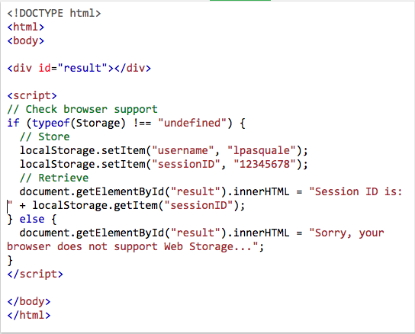
Notes:
Any time you create an HTML form, you can create as many hidden variables as you need to store information that needs to be available in the next step of processing. These hidden variables are exactly like any other CGI variable, but there is no visible sign of the variable on the form that is displayed in the user's browser.

Slide 42
Attack Resistance Analysis
Examples of uncovered flaws
Misues of cryptographic primitives:
Avoid weak algorithms such as MD5 and SHA
Avoid using weak randomization libraries to generate cryptographic keys.
C library: random(), rand() → use getrandom instead
Java library: Java.Util.Random() → use java.security.SecureRandom instead

Slide 43
Architectural Risk Analysis Activities
Build a one-page overview of your system
Attack Resistance Analysis
Weakness Analysis
Ambiguity Analysis
Notes:
The proposed ranking is based on years of experience that Gary McGraw acquired by applying touchpoints to many different types of organizations ranging from independent software vendors to huge credit card consortium

Slide 44

Ambiguity Analysis
The creative activity required to identify new risks
Separate Attack Resistance Analysis Activities
Experienced security analyst
Experienced security analyst
Notes:
2 team members who carry separate analysis activities and some amount of experience. It only works best when performed by very experienced analysts

Slide 45
Ambiguity Analysis
The creative activity required to identify new risks
Separate Attack Resistance Analysis Activities
Experienced security analyst
Experienced security analyst
Discussion of Results
Notes:
2 team members who carry separate analysis activities and some amount of experience. It only works best when performed by very experienced analysts

Slide 46
Ambiguity Analysis
Examples of uncovered flaws
Protocol/Authentication Problem
possible search space adopted to look for an authentication key is very small and can be guessed using brute force.
Simple Password Retrieval mechanisms and weak password strength
Notes:
2 team members who carry separate analysis activities and some amount of experience. It only works best when performed by very experienced analysts

Slide 47
Architectural Risk Analysis Activities
Build a one-page overview of your system
Attack Resistance Analysis
Weakness Analysis
Ambiguity Analysis
Notes:
The proposed ranking is based on years of experience that Gary McGraw acquired by applying touchpoints to many different types of organizations ranging from independent software vendors to huge credit card consortium

Slide 48
Weakness Analysis
Aims at uncovering weaknesses determined by external software that is used
Requires consideration of:
External software components (e.g., security features packages such as RSA)
Frameworks (e.g., JEE, .NET)
Platform (e.g., Mobile Device, Windows platforms)
Network Topology
Physical environment (storage devices like USB)
Build environment (e.g., broken compilers)
Notes:
Understand what kindsof assumptions you are making about outside software and what will happen when those assumptions fail

Slide 49
Weakness Analysis
Examples of uncovered flaws
Browsers failures: plugin system can be exploited by malicious attackers.
Interposition attacks: e.g., main-in-the-middle attacks

Slide 50
7 Best Practices (Touchpoints)
Some touchpoints are more powerful than others
Code Review
Architectural Risk Analysis
Penetration testing
Risk-based security tests
Abuse cases
Security requirements
Security operations
Notes:
The proposed ranking is based on years of experience that Gary McGraw acquired by applying touchpoints to many different types of organizations ranging from independent software vendors to huge credit card consortia

Slide 51
7 Best Practices (Touchpoints)
Security best practices
Design
Implementation
Testing
Software engineering activities

Slide 52
Penetration Testing
Running a series of functional dynamic tests late in the lifecycle
Positives:
Probing the system in its final operating environment
Attractive as a late life-cycle activity
Negatives
A majority of security defects and vulnerabilities in software involve often unexpected but intentioanl misues of an application discovered by an attacker.
Findings depend on the skills of the testers
Problems that are found at this stage are hard to fix
Notes:
Uncovering environment and configuration problems and concerns is the best result of penetration test because these results can be fixed late in the lifecycle

Slide 53
7 Best Practices (Touchpoints)
Some touchpoints are more powerful than others
Code Review
Architectural Risk Analysis
Penetration testing
Risk-based security tests
Abuse cases
Security requirements
Security operations
Notes:
The proposed ranking is based on years of experience that Gary McGraw acquired by applying touchpoints to many different types of organizations ranging from independent software vendors to huge credit card consortia

Slide 54
Risk-Based Security Tests
Design
Implementation
Testing

Slide 55
Risk-Based Security Test
Focuses on validating application conformance to security requirements and application specific security policies.
Usually runs in parallel to integration testing
Testing of security functionalities with standard functional testing techniques.
Perform risk-based security testing based on attack patterns and risk analysis results.

Slide 56
7 Best Practices (Touchpoints)
Some touchpoints are more powerful than others
Code Review
Architectural Risk Analysis
Penetration testing
Risk-based security tests
Abuse cases
Security requirements
Security operations
Notes:
The proposed ranking is based on years of experience that Gary McGraw acquired by applying touchpoints to many different types of organizations ranging from independent software vendors to huge credit card consortia

Slide 57
Abuse Case
Design
Implementation
Testing

Slide 58
Abuse Cases
Similar to UML Use Cases but describe the system behaviour under attack.
Require Explicit coverage of what should be protected, by whom and for how long
Notes:
Abuse cases are a great way to get into the mind of an attacker
Building abuse cases requires explicit coverage of what should be protected, by whom and for how long

Slide 59
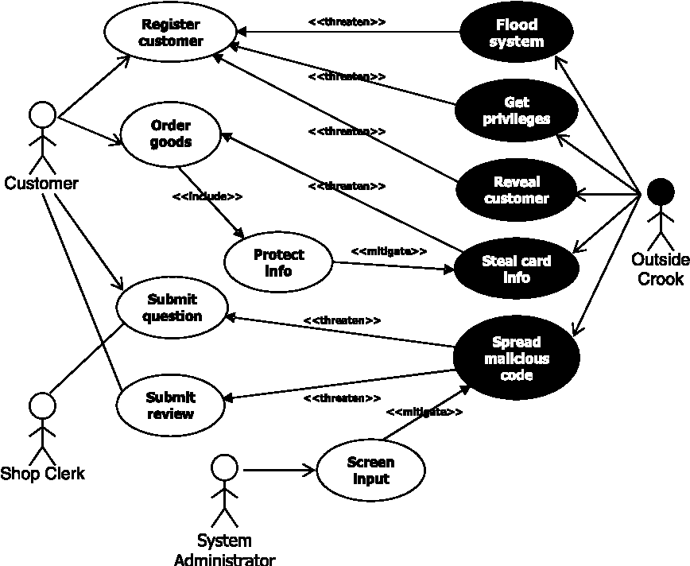
Abuse Cases
Similar to UML Use Cases but describe the system behaviour under attack.
Require Explicit coverage of what should be protected, by whom and for how long
Notes:
Abuse Case example

Slide 60
7 Best Practices (Touchpoints)
Some touchpoints are more powerful than others
Code Review
Architectural Risk Analysis
Penetration testing
Risk-based security tests
Abuse cases
Security requirements
Security operations
Notes:
The proposed ranking is based on years of experience that Gary McGraw acquired by applying touchpoints to many different types of organizations ranging from independent software vendors to huge credit card consortia

Slide 61
Security Requirements
Design
Implementation
Testing

Slide 62
7 Best Practices (Touchpoints)
Some touchpoints are more powerful than others
Code Review
Architectural Risk Analysis
Penetration testing
Risk-based security tests
Abuse cases
Security requirements
Security operations
Notes:
The proposed ranking is based on years of experience that Gary McGraw acquired by applying touchpoints to many different types of organizations ranging from independent software vendors to huge credit card consortia

Slide 63
7 Best Practices (Touchpoints)
Involve network security experts
Acquire knowledge of software behaviour that lead to successful attacks
Notes:
Involve network security experts providing experience and security wisdom that might otherwise be missing from the development team. Software security can benefit greatly from network security. Attacks do happen regardless of the strength of design and implementation, so understanding software behaviour that leads to successful attack is an essential defensive technique.

